Slide 1
Here is Crypto
Your guide on
- Blockchain Overview
Your Digital Asset
Your public address and private keys
- “How to” Guide on accessing your funds
-Recommended Exchanges
-

Slide 2
Blockchain overview
Blockchain defined: Blockchain is a shared, immutable ledger that facilitates the process of recording transactions and tracking assets in a business network. An asset can be tangible (a house, car, cash, land) or intangible (intellectual property, patents, copyrights, branding). Virtually anything of value can be tracked and traded on a blockchain network, reducing risk and cutting costs for all involved.
Why blockchain is important: Business runs on information. The faster it’s received and the more accurate it is, the better. Blockchain is ideal for delivering that information because it provides immediate, shared and completely transparent information stored on an immutable ledger that can be accessed only by permissioned network members. A blockchain network can track orders, payments, accounts, production and much more. And because members share a single view of the truth, you can see all details of a transaction end to end, giving you greater confidence, as well as new efficiencies and opportunities.

Slide 3
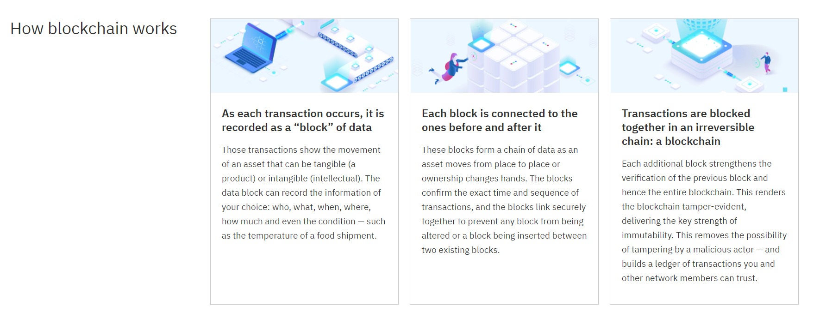

Slide 4
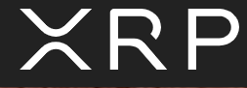
XRP is a digital asset built for payments. It is the native digital asset on the XRP Ledger—an open-source, permissionless and decentralized blockchain technology that can settle transactions in 3-5 seconds.
XRP can be sent directly without needing a central intermediary, making it a convenient instrument in bridging two different currencies quickly and efficiently.
How is XRP used
Faster, less costly and more scalable than any other digital asset, XRP and the XRP Ledger are used to power innovative technology across the payments space.
Ripple is focused on building technology to help unleash new utility for XRP and transform global payments. Third parties are also pursuing other XRP-related use cases.
Learn more at www.ripple.com

Slide 5
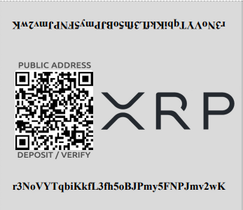
Your Public Address *Wallet*

Slide 6
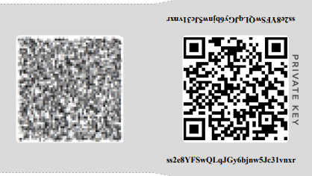
Your Private Address *Keys*

Slide 7
How to access funds
Download the XUMM app for IOS or Android.
Open the XUMM app and follow the setup process to set your pin code and acknowledge the terms.
The XUMM app will give you 8 rows of 6 secret numbers. Keep these in a secure location; they will be used to restore your XUMM account if you ever lose access.
Next, click the “Import existing account” button. Leave the selection on “Full access” and click the “Next” button.
You will be given the option of importing your wallet. Select “Mnemonic” and then click the “Next, I understand” button.
You will be given the option of importing your wallet from your phone’s camera. Select “Scan from QR” and scan your Keys from your private address
Once you’re done importing your XRP paper wallet into the XUMM app, you can transfer your XRP to a crypto exchange, hardware wallet, or another offline wallet.

Slide 8
How to access funds cont…
Now that you have your wallet imported in XUMM, you will be given the option to send your XRP.
Once you’ve made an account on one of the recommended exchanges, locate your XRP wallet’s unique address and destination tag.
On the XUMM app’s home screen wallet locate the “display send and request” button
Click the “Send” button under your imported wallet. Now, enter your destination address and destination tag of the wallet you’ve created. Within a few seconds, you should receive the XRP in the wallet you sent your XRP to.

Slide 9
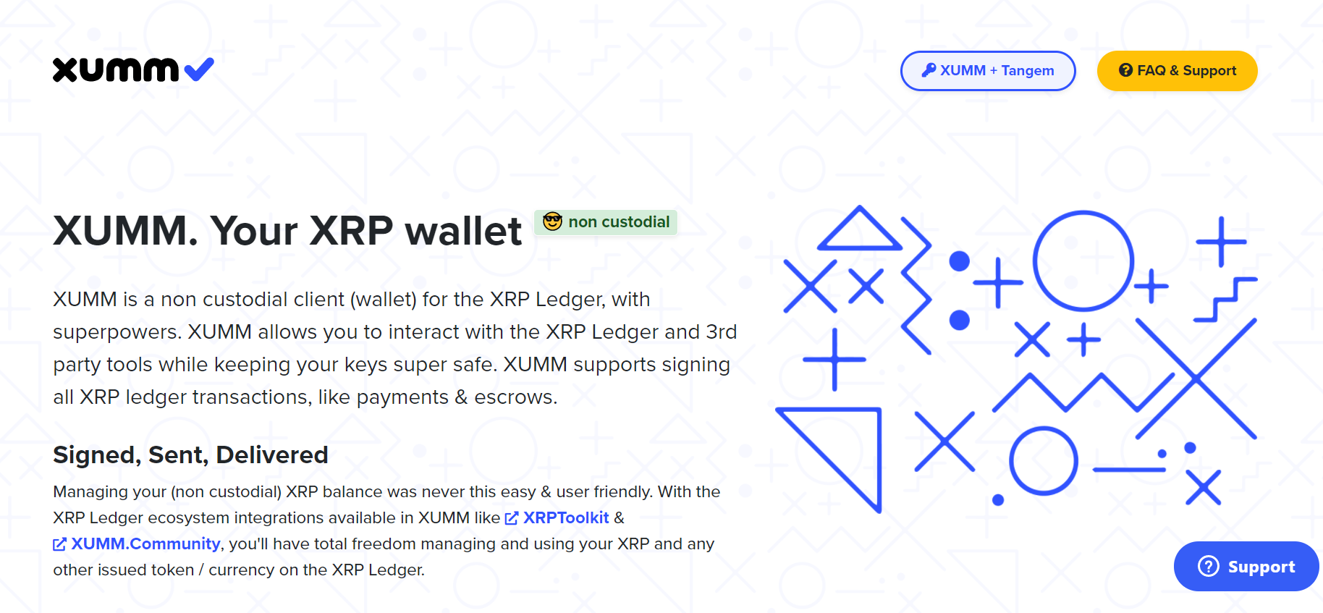

Slide 10
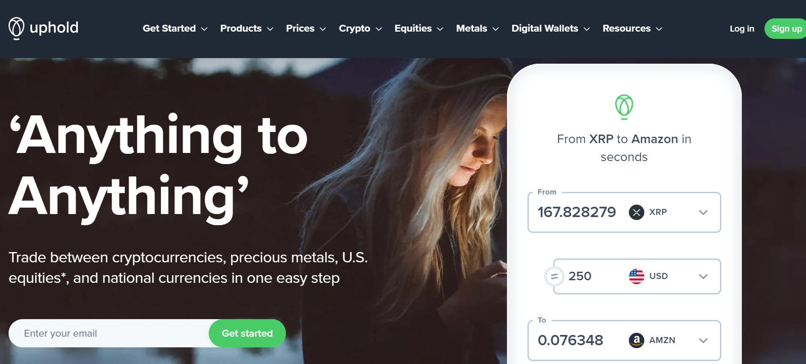
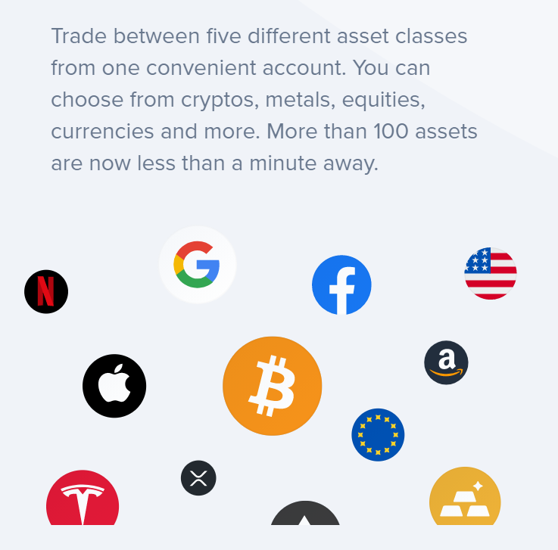
Recommended Exchanges
Uphold serves 184+ countries, across 30+ currencies (traditional and crypto) and commodities with frictionless foreign exchange and cross-border remittance for members around the world. Since our launch in 2015, Uphold has powered more than US$4+ billion in transactions.
Uphold combines a platform app model with payment connectivity to offer financial services to a global market. Uphold empowers innovation in financial services through a platform approach where app developers and fintech partners can leverage Uphold’s reach through licensed relationships with banks and financial services partners around the world. Built on a core of proprietary technologies and e-money apps, Uphold embraces a future where people and businesses around the world have access to safe, transparent, fair and affordable financial services.
Lean more at www.uphold.com

Slide 11
CONGRADULATIONS
$250.00
sent to
Transaction Date ___________
Amount Sent ___________
Blockchain ID ___________

